Slide 1
Pitch Deck Presentation:
Insights from Social Media Usage Data

Slide 2
Dataset and Goals
Dataset:
Human Stampedes (average time spent by a user on social media)
Goals:
Analyze user behavior and preferences to derive actionable insights for marketing strategies and user engagement.

Slide 3
Data Import and Initial Findings
Import Process
Method:
Imported dataset into MySQL Workbench for analysis.
Challenges:
Ensured data integrity and handled missing values during import.
Interesting Finding
Discovered significant variations in time spent across different demographics and geographic locations.

Slide 4
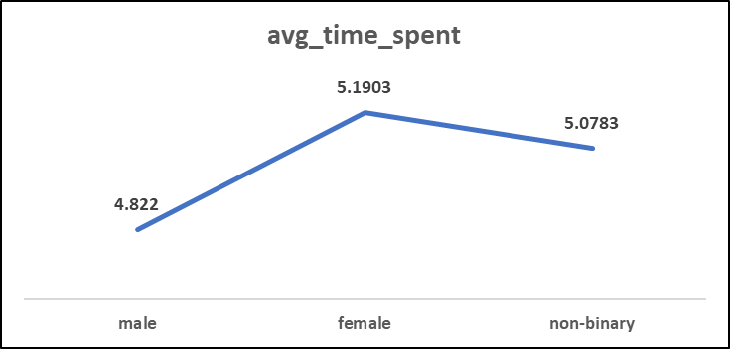
Cool Facts Discovered
Female spend more time in social media platform, followed by the non-binary and males spend less time on social media.

Slide 5
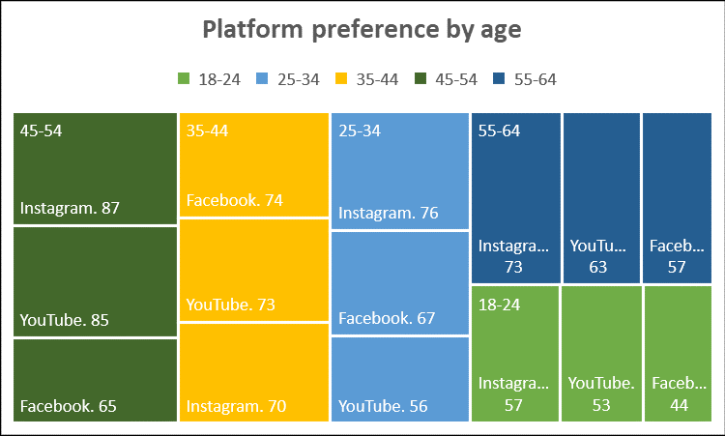
Cool Facts Discovered cont…
Instagram is highly preferred among all age group except 35-44, who prefer facebook
18-24 Age Group: Instagram is the top platform, followed by YouTube and then Facebook.
25-34 Age Group: Instagram leads, with Facebook and YouTube following.
35-44 Age Group: Facebook is the most popular, with YouTube and Instagram close behind.
45-54 Age Group: Instagram is preferred, closely followed by YouTube, with Facebook being the least preferred.
55-64 Age Group: Instagram is the top platform, followed by YouTube and Facebook.

Slide 6
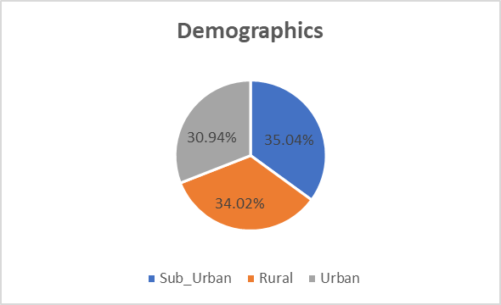
Questions Explored and SQL Queries Used
What are the most common demographics of users who spend more than 3 hours per day on social media?
People in Sub_Urban areas spend more than 3 hours per day on social media, followed by Rural area folks and lastly urban folks

Slide 7
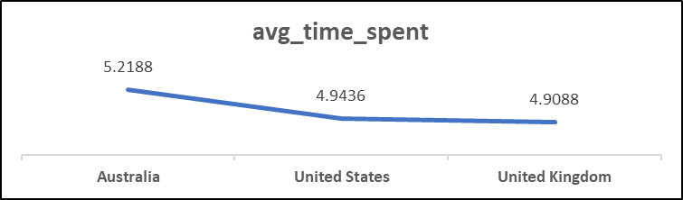
Questions Explored and SQL Queries Used
2. Which location has the highest average time spent on social media?

Slide 8
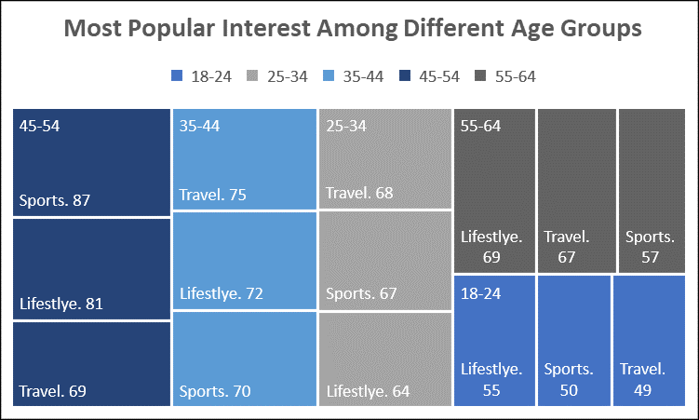
Questions Explored and SQL Queries Used cont…

Slide 9
Project Summary
Key Takeaways
Gender and age significantly influence social media behavior.
Tailored marketing strategies based on demographic insights can enhance engagement.
Continuous monitoring of trends is crucial for adapting strategies in a dynamic digital landscape.

